Slide 1
The craft of business driven design

Slide 2
Agenda
We will learn one strategic design pattern in Domain driven design
This is the most important and fundamental pattern in Domain driven design

Slide 3
All problems , functions and objects depicted in this workshop are entirely fictitious. Any similarity to actual problems , classes or functions living or dead, is purely coincidental.

Slide 4
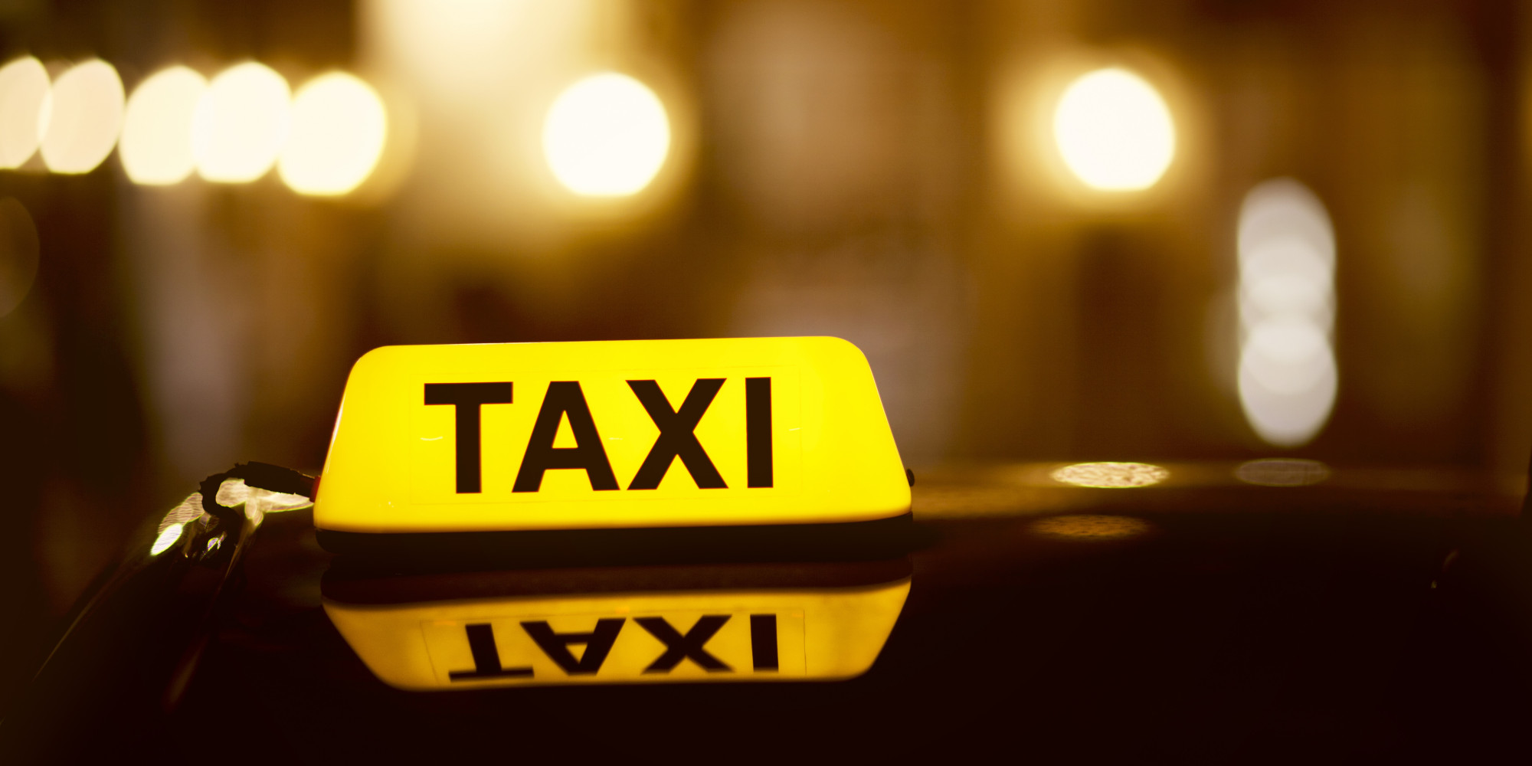
Section Change Slide

Slide 5
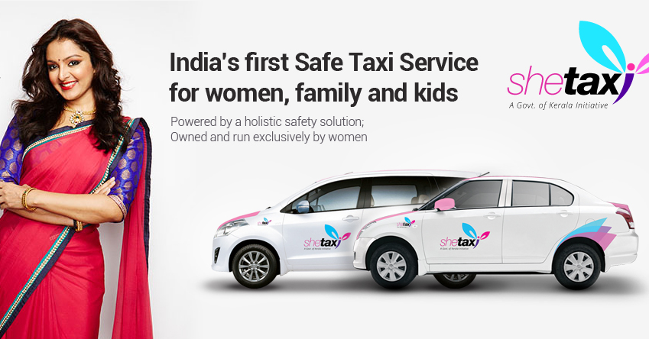

Slide 6
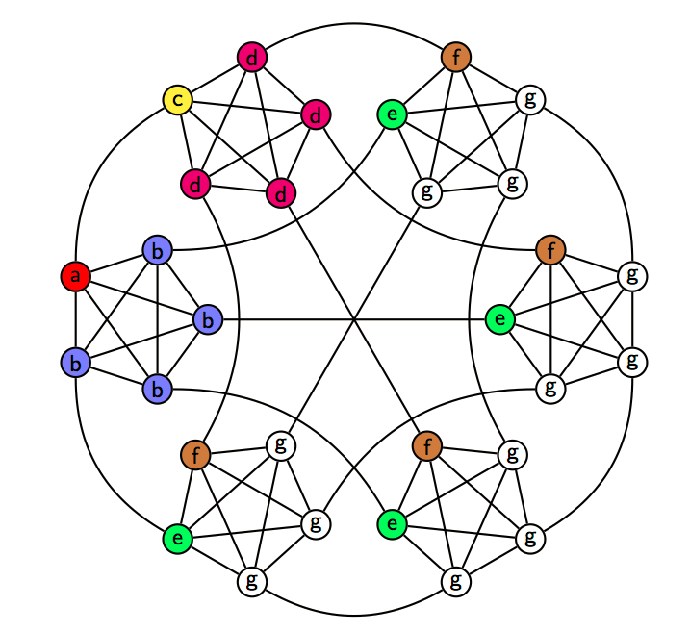
Booking system
administration
Operator
Reports
Name
Id
Login()
book(Customer)
AddCab( cab)
Add Customer ()
ActivateCab()
DeActivateCab()
sendSMS()
Trip
LocID SrcID
LocID DesID
Cab
Customer
route
Cab Tracker
getCabs(Count , SrcID )
Route getRoute(SrcID , DesID )
Customer
Cab
Name
Phone
ID
Driver Name
Phone No
ID
Route
List <LocID>
ID | Customer name | ph
ID | Driver name | ph
Legacy system design

Slide 7
A
As a customer of SheTaxi , I want to book the nearest SheTaxi based on my GPS location so that I reach my destination ASAP.
As a car owner, I want to attach myself to SheTaxi so that I get more customers
As a customer of SheTaxi , I want to view the rate card so that I can estimate the fare .

Slide 8
B
As a customer of SheTaxi , I want to view available cabs based on a given gps location so that I get approximate time I need to wait after booking .
As a customer of SheTaxi , I want to view the approximate fare of my journey so that I can estimate the fare .
As the management of SheTaxi , I want customers to rate the driver in a scale of 1 to 5 , 1 being worst and 5 being best , so we can get feedback and improve our services .

Slide 9
C
As the management of SheTaxi, we want to track the exact route using GPS coordinates , time taken and distance travelled so that SheTaxi can generate invoices to customers .
As a SheTaxi cabdriver , I want to get a route map (GPS coordinates ) based on my customers destination and pickup point so that I can complete my trip ASAP.
As the management of SheTaxi , we want an exclusive feature for our VIP customers, an option to book cab drivers with rating 4+ so that we can retain our VIP customers.

Slide 10
D
As a customer of SheTaxi , I want my invoice be emailed so that I need not ask for a written invoice.
As the management of SheTaxi , I want to access previous trip data for each drivers so that we can make weekly payments to them
As the management of SheTaxi , we want an exclusive feature for our VIP customers, an option to integrate their invoices to ” www.expensify.com”

Slide 11
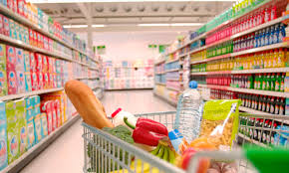
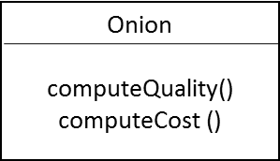
Example : Super Market I 'am using a simple example to explain the problem , same is applicable for bigger complex systems
The super market has many products to sell
Each product has a
quality
cost
The rules for computation of Quality and Cost are different for each product
Example of a concreate product
Concreate product 1
Abstract Product
computeQuality()
computeCost ()
Concreate product 2
Concreate product n-1
Concreate product N

Slide 12

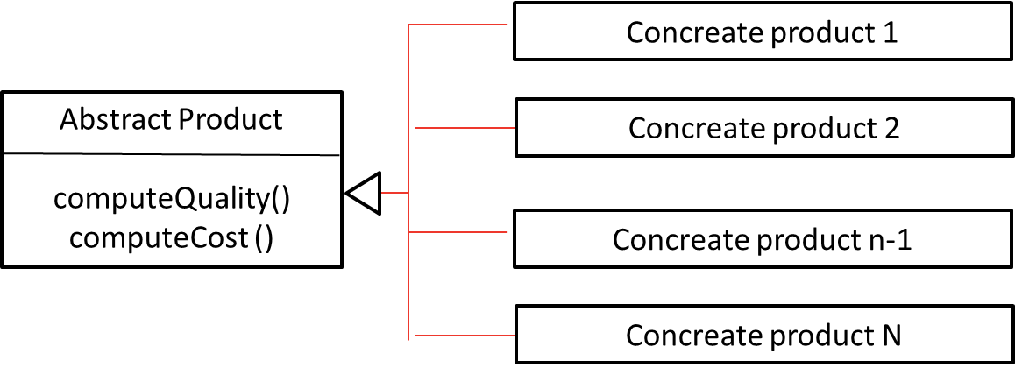
Is this the best design ?
Onion
computeQuality()
computeCost ()
Is this following SRP ? Single responsibility principle
SRP : A class should have only one reason to change
What if the pricing strategy of a product varies from time to time ?

Slide 13

How about a different design
Concreate product 1
Abstract Product
Pricing strategy
computeQuality()
Concreate product 2
Concreate product n-1
Concreate product N
Strategy 1
PricingStrategy
CompteCost()
Strategy 2
Strategy 3

Slide 14

Another design
Product
PricingStrategy
QualityRule
Rule 1
QualityRule
Quality()
Rule 2
Strategy 1
PricingStrategy
CompteCost()
Strategy 2
Strategy 3

Slide 15

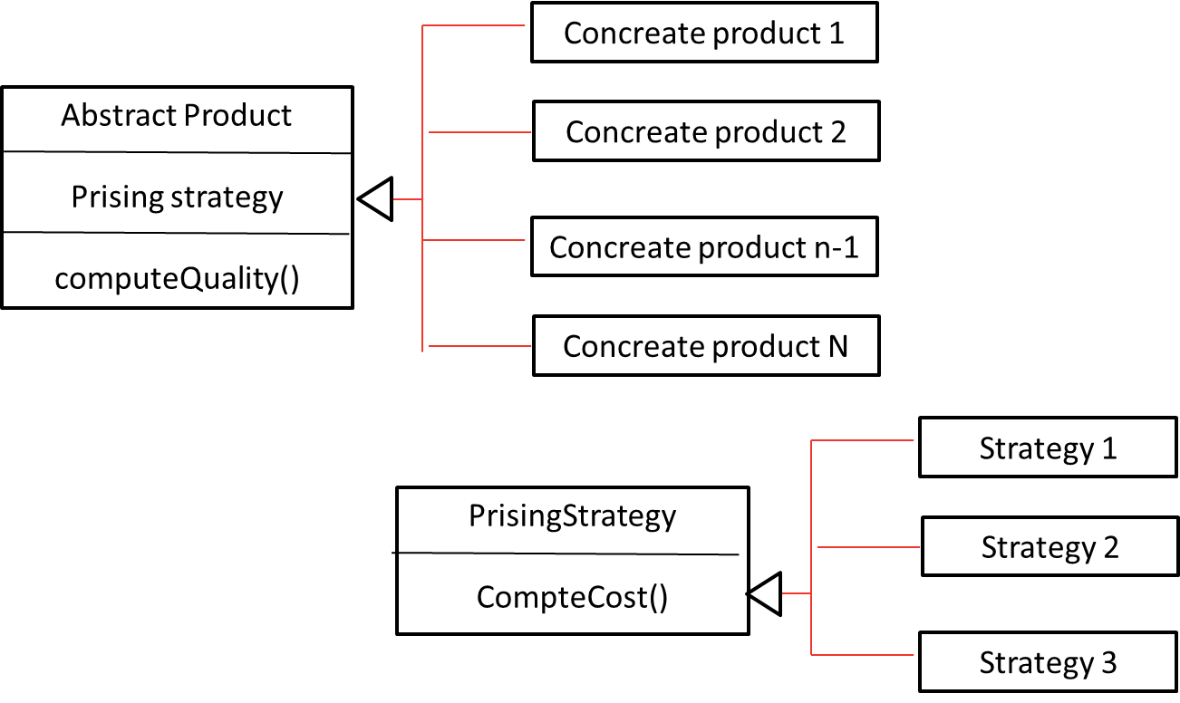
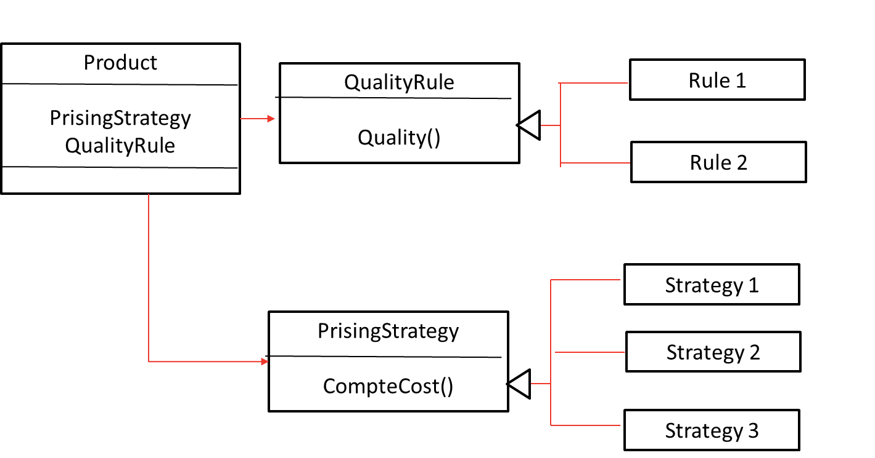
Which design is better ?

Slide 16
Which design is better ?
Answer is : it depends
Dependents on what ?
Lest try to define this context
Context

Slide 17
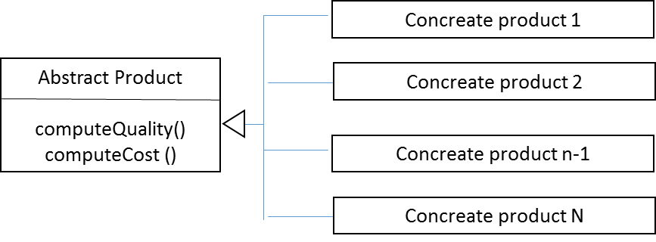

Which design is better ?
If mostly we will be only adding / removing products

Slide 18
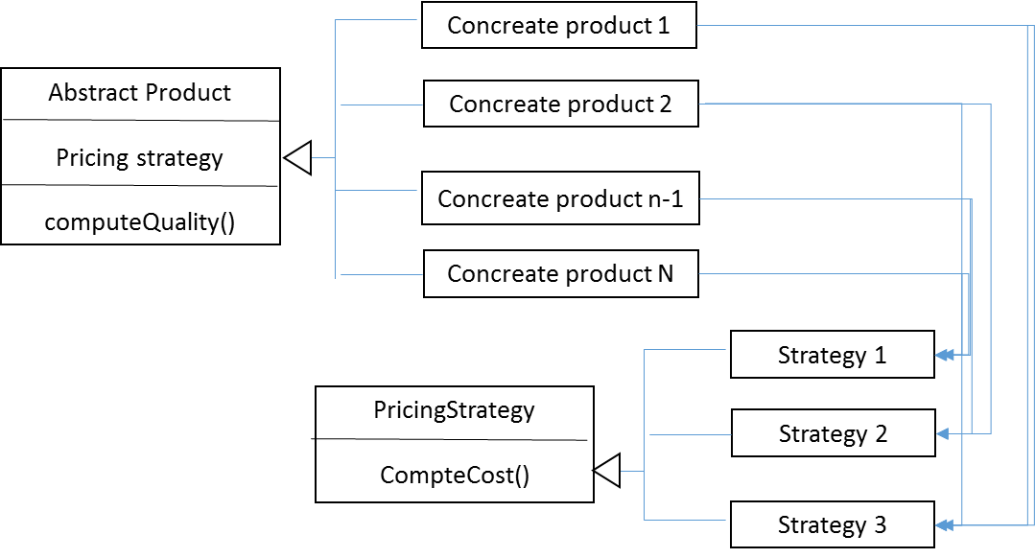
Which design is better ?
We will be constantly adding new products , also
We need to modify pricing strategy every now and then for existing products

Slide 19
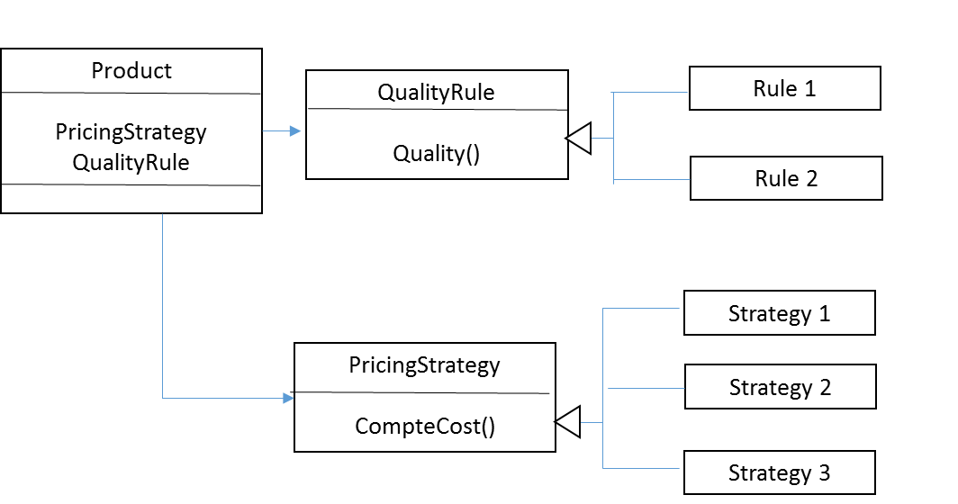
Which design is better ?
We need to often modify both pricing strategy & quality rule for existing products

Slide 20

There is nothing like a good or bad design we can only evaluate a design once we associate it with a context The context is the actual business problem we need to solve

Slide 21
Team A
Team B
Coordinate geometry package
Graphics rendering package
Core library

Slide 22
Team A
Team B
Coordinate geometry package
Graphics rendering package
The dirty evolution of rectangle class
float x , float y , float length, float breath
Line getDiagonal()
Float getDistanceFromPoint(Point)
Void transform(Matrix)
Float getSurfaceArea…………
float x , float y , float length, float breath
Image Texture;
Line get Diagonal ()
Matrix Convert (matrix)
Float getDistanceFromPoint(Point)
Void transform(Matrix)
Float getSurfaceArea
Void Scale (int x)
Void deform (matrix)
float x , float y , float length, float breath , int height , int width
Image Texture;
Line get Diagonal()
Matrix Convert (matrix)
Float getDistanceFromPoint(Point)
Void transform(Matrix)
Float getSurfaceArea
Void Scale (int x)
Void deform (matrix)
……

Slide 23
Team A
Team B
Coordinate geometry package
Graphics rendering package
Core library

Slide 24
If design reuse is done incorrectly it could contaminate the entire system

Slide 25


Slide 26
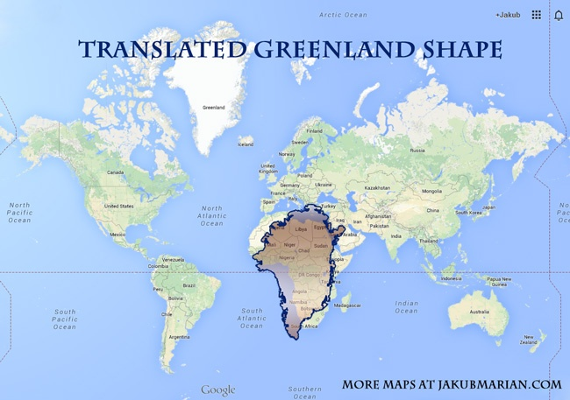
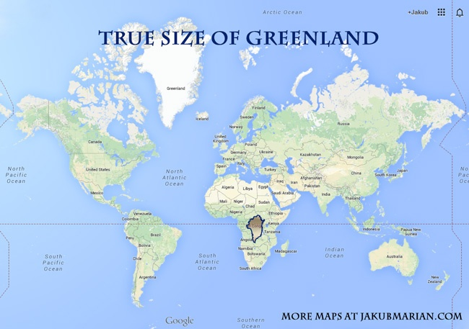

Slide 27
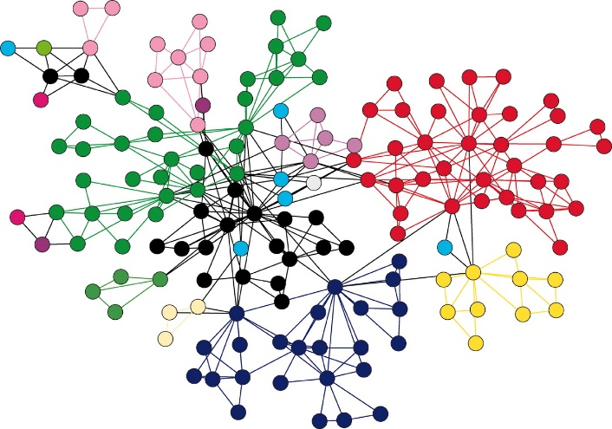
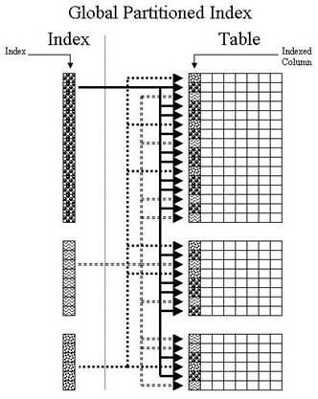
Which design decision is better to store cab locations in real time ?
Accuracy ++
Complexity++
Retrieval performance –-
Shortest route++
Accuracy --
Simplicity ++
Retrieval performance++
Shortest route --

Slide 28
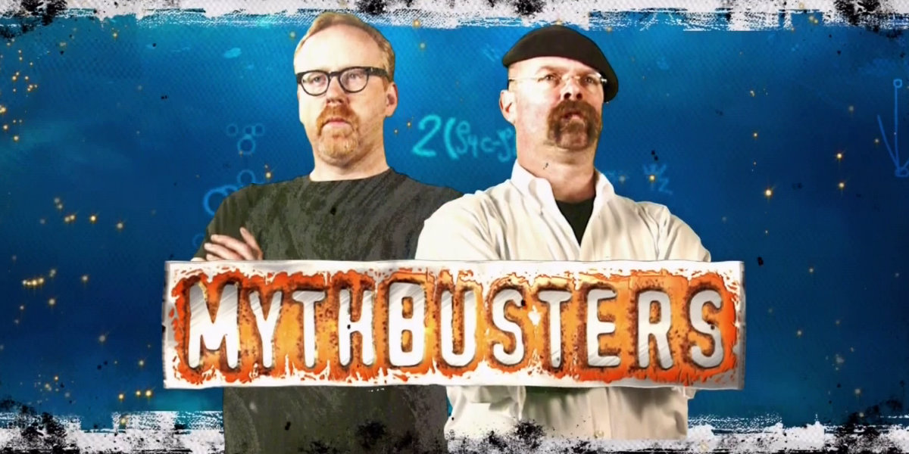
Design reuse is always good
Software design should strive towards perfection

Slide 29
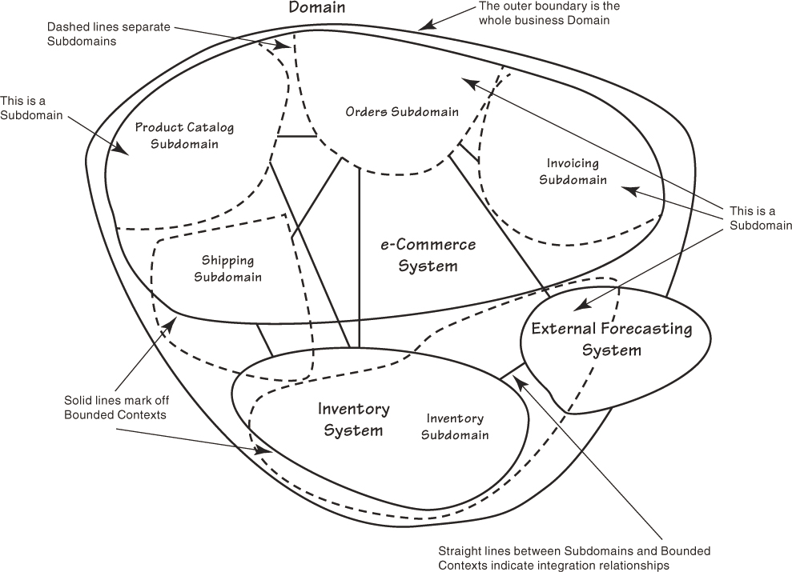
Domain , sub domain and Bounded Context

Slide 30
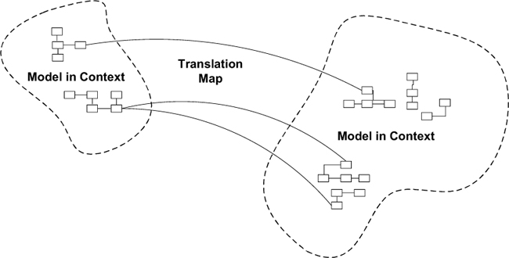
Context Map

Slide 31
Design reuse is always good within its bounded context
Software design should strive towards perfection with in its bounded context

Slide 32
Let apply what we learned and redesign

Slide 33
Present your design

Slide 34
Domain Driven Design what we didn’t cover
Ubiquitous language
Entity
Value Object
Aggregate
Domain Event
Service
Repository
Factory

Slide 35
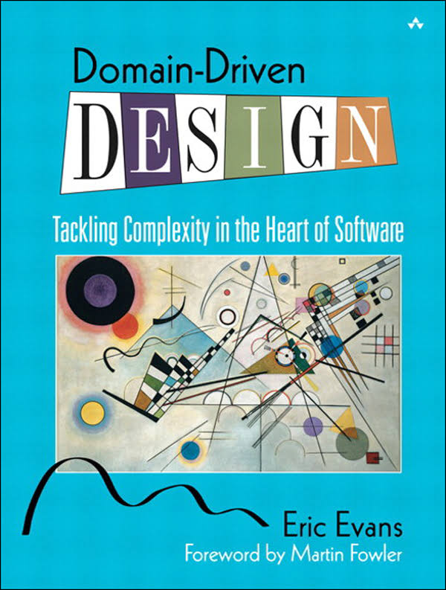
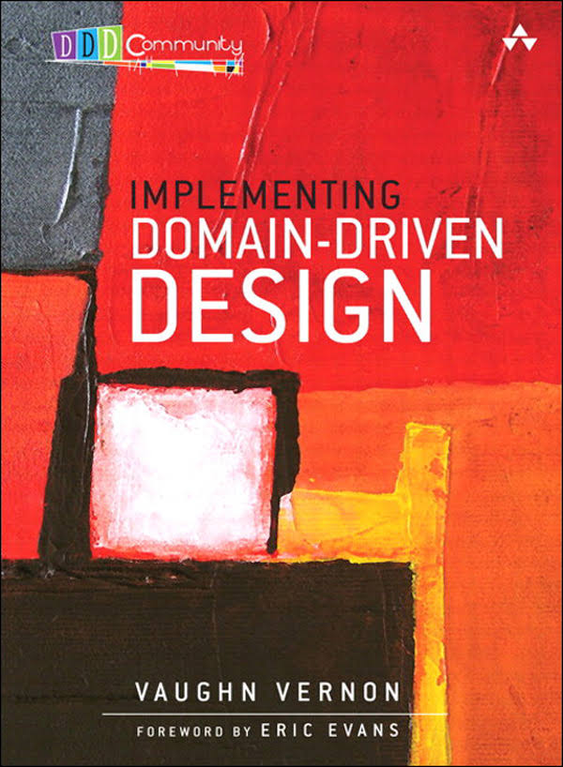
If your bitten by the DDD bug you have two choices ,the blue pill or the red pill

Slide 36
Questions

